Slide 1
School Drop-off/Pick-up Model Integration
ActivitySim Consortium Meeting
August 4, 2022

Slide 2
School Drop-off/Pick-up Model
Used to link drivers (chauffeurs / chaperones) with children who go to school (escortees)
Chauffeurs and escortees linked by direction
  Outbound (drop-off)
  Inbound (pick-up)
Escort type
  Pure: Tour purpose of driver = escort
  Ride-share: Tour purpose of driver = work\school
“Bundles”
  A driver, with one or more children, by direction, and purpose
Forms tours & trips explicitly

Slide 3
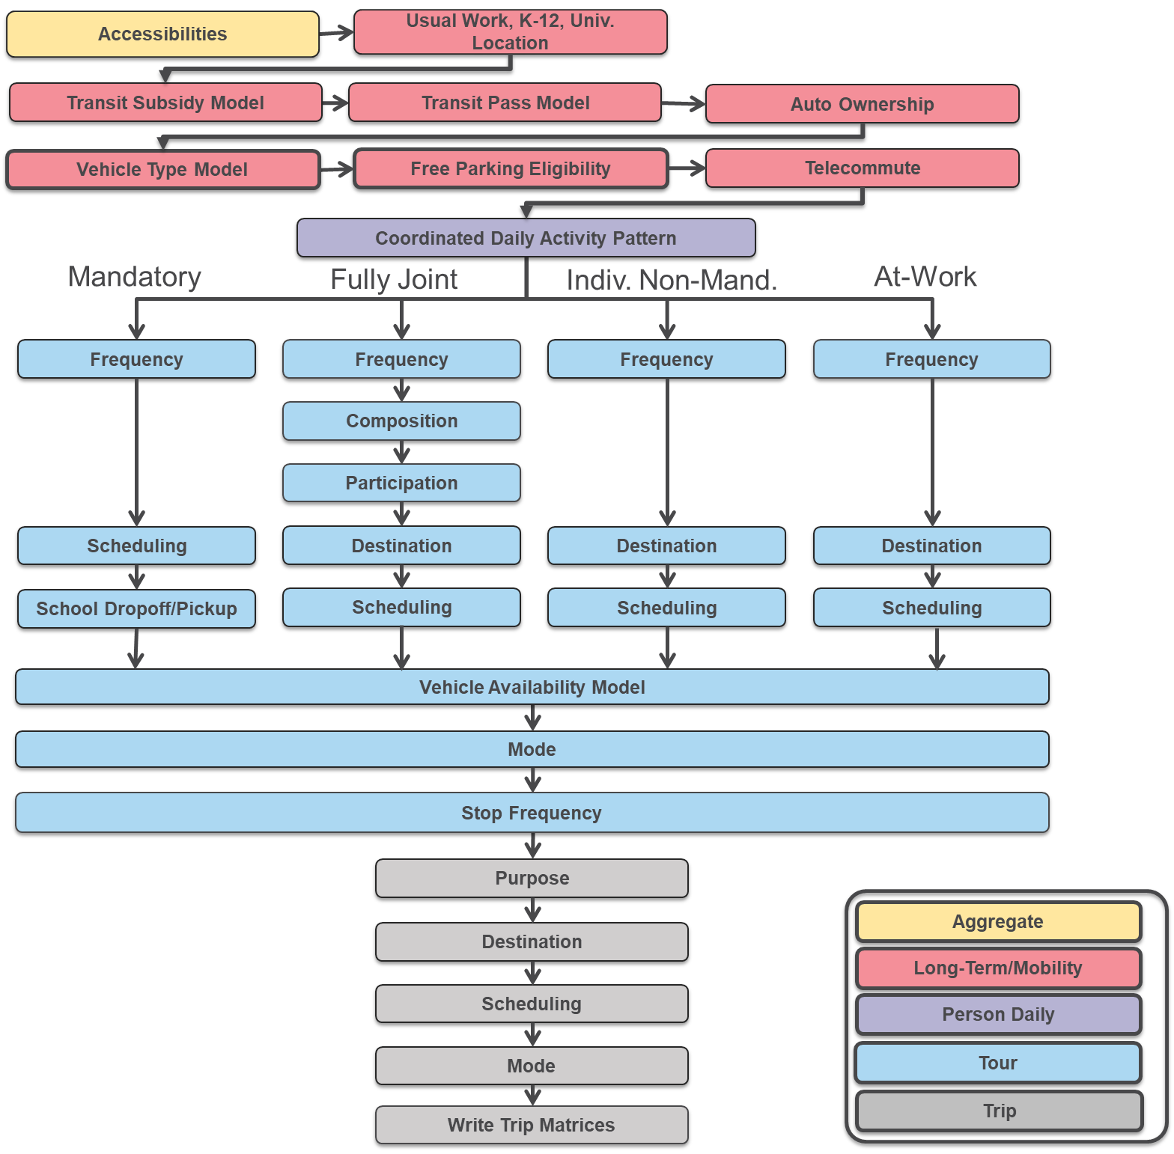
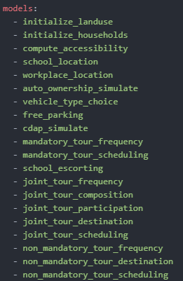
Model Flow

Slide 4
Today’s Agenda: After School Escorting Decision Made
Constructing escorting bundle data for each household
Construct school escorting trips and tours for each bundle
Integrate created school escorting tours and trips with downstream models
  Destinations, schedules, stop purposes, etc. all need to be consistent

Slide 5
Alternatives
Alt | bundle1 | bundle2 | bundle3 | chauf1 | chauf2 | chauf3 | nbund1 | nbund2 | nbundles | nrs1 | npe1 | nrs2 | npe2 | Description
1 | 0 | 0 | 0 | 0 | 0 | 0 | 0 | 0 | 0 | 0 | 0 | 0 | 0 | no one is escorted
2 | 1 | 0 | 0 | 1 | 0 | 0 | 1 | 0 | 1 | 1 | 0 | 0 | 0 | child 1 is escorted in bundle 1 by chauffeur 1 as ride sharing
3 | 1 | 0 | 0 | 2 | 0 | 0 | 1 | 0 | 1 | 0 | 1 | 0 | 0 | child 1 is escorted in bundle 1 by chauffeur 1 as pure escort
4 | 1 | 0 | 0 | 3 | 0 | 0 | 0 | 1 | 1 | 0 | 0 | 1 | 0 | child 1 is escorted in bundle 1 by chauffeur 2 as ride sharing
5 | 1 | 0 | 0 | 4 | 0 | 0 | 0 | 1 | 1 | 0 | 0 | 0 | 1 | child 1 is escorted in bundle 1 by chauffeur 2 as pure escort
6 | 0 | 1 | 0 | 0 | 1 | 0 | 1 | 0 | 1 | 1 | 0 | 0 | 0 | child 2 is escorted in bundle 1 by chauffeur 1 as ride sharing
7 | 0 | 1 | 0 | 0 | 2 | 0 | 1 | 0 | 1 | 0 | 1 | 0 | 0 | child 2 is escorted in bundle 1 by chauffeur 1 as pure escort
 |  |  |  |  |  | … |  |  |  |  |  |  |  | ….
14 | 1 | 1 | 0 | 1 | 1 | 0 | 1 | 0 | 1 | 1 | 0 | 0 | 0 | child 1 and 2 are escorted in bundle 1 by chauffeur 1 as ride sharing
15 | 1 | 1 | 0 | 2 | 2 | 0 | 1 | 0 | 1 | 0 | 1 | 0 | 0 | child 1 and 2 are escorted in bundle 1 by chauffeur 1 as pure escort
16 | 1 | 1 | 0 | 3 | 3 | 0 | 0 | 1 | 1 | 0 | 0 | 1 | 0 | child 1 and 2 are escorted in bundle 1 by chauffeur 2 as ride sharing
17 | 1 | 1 | 0 | 4 | 4 | 0 | 0 | 1 | 1 | 0 | 0 | 0 | 1 | child 1 and 2 are escorted in bundle 1 by chauffeur 2 as pure escort
18 | 1 | 0 | 1 | 1 | 0 | 1 | 1 | 0 | 1 | 1 | 0 | 0 | 0 | child 1 and 3 are escorted in bundle 1 by chauffeur 1 as ride sharing
26 | 1 | 2 | 0 | 1 | 2 | 0 | 2 | 0 | 2 | 1 | 1 | 0 | 0 | child 1 is escorted in bundle 1 by chauffeur 1 as ride sharing and child 2 is escorted in bundle 2 by chauffeur 1 as pure escort
27 | 1 | 2 | 0 | 1 | 3 | 0 | 1 | 1 | 2 | 1 | 0 | 1 | 0 | child 1 is escorted in bundle 1 by chauffeur 1 as ride sharing and child 2 is escorted in bundle 2 by chauffeur 2 as ride sharing
28 | 1 | 2 | 0 | 1 | 4 | 0 | 1 | 1 | 2 | 1 | 0 | 0 | 1 | child 1 is escorted in bundle 1 by chauffeur 1 as ride sharing and child 2 is escorted in bundle 2 by chauffeur 2 as pure escort
29 | 1 | 2 | 0 | 2 | 1 | 0 | 2 | 0 | 2 | 1 | 1 | 0 | 0 | child 1 is escorted in bundle 1 by chauffeur 1 as pure escort and child 2 is escorted in bundle 2 by chauffeur 1 as ride sharing
 |  |  |  |  |  | … |  |  |  |  |  |  |  | ….
Bundle of child
# of bundles for chauf
chauffer of child:
1 – chauf 1 RS
2 – chauf 1 PE
3 – chauf 2 RS
4 – chauf 2 PE
Combining children, chauffeurs, and escort type options yields
157 possible combinations
(chauffeurs can’t take two rideshare bundles)

Slide 6
School Escort Model Output
School Escorting is a household level decision
  Each decision is added to the households table
household_id | school_escorting_outbound | school_escorting_inbound | school_escorting_outbound_cond
1810015 | 2 | 2 | 2
1099626 | 4 | 5 | 4
1196298 | 53 | 42 | 67
386761 | 5 | 5 | 5
370497 | 1 | 1 | 1
1173905 | 17 | 39 | 15
386699 | 1 | 5 | 1
1645132 | 1 | 1 | 1
1747467 | 1 | 3 | 1
1259353 | 3 | 3 | 3

Slide 7
School Escort Bundles
Constructing a list of individual school escort bundles
  Bundle = Chauffeur + escortees + direction
household_id | school_escort_direction | chauf_id | escort_type | escortees | school_dests | school_starts | school_ends | school_tour_ids | chauf_tour_id | Description
304004 | inbound | 418377 | pure_escort | 418378 | 21 | 8 | 16 | 17153529 | 30400401 | child 1 is escorted in bundle 1 by chauffeur 1 as pure escort
304087 | inbound | 418543 | pure_escort | 418544 | 7 | 7 | 20 | 17160335 | 30408701 | child 1 is escorted in bundle 1 by chauffeur 1 as pure escort
356821 | outbound | 554656 | pure_escort | 554658 | 9 | 10 | 17 | 22741009 | 35682103 | child 1 is escorted in bundle 1 by chauffeur 1 as pure escort and child 2 is escorted in bundle 2 by chauffeur 1 as pure escort
356821 | outbound | 554656 | pure_escort | 554657 | 10 | 7 | 10 | 22740968 | 35682104 | child 1 is escorted in bundle 1 by chauffeur 1 as pure escort and child 2 is escorted in bundle 2 by chauffeur 1 as pure escort
370328 | inbound | 595177 | pure_escort | 595179_595178 | 8_11 | 8_6 | 14_13 | 24402370_24402329 | 37032801 | child 1 and 2 are escorted in bundle 1 by chauffeur 1 as pure escort
370348 | inbound | 595237 | pure_escort | 595239_595238 | 9_10 | 7_8 | 14_15 | 24404830_24404789 | 37034801 | child 1 and 2 are escorted in bundle 1 by chauffeur 1 as pure escort
1931969 | outbound | 4763317 | ride_share | 4763324_4763322 | 17_9 | 9_8 | 16_16 | 195296315_195296233 | 195296036 | child 1 and 2 are escorted in bundle 1 by chauffeur 2 as ride sharing
431984 | outbound | 846428 | pure_escort | 846431_846430 | 8_22 | 7_8 | 15_15 | 34703702_34703661 | 43198402 | child 1 and 2 are escorted in bundle 1 by chauffeur 1 as pure escort
431984 | inbound | 846428 | pure_escort | 846430_846431 | 22_8 | 8_7 | 15_15 | 34703661_34703702 | 43198401 | child 1 and 2 are escorted in bundle 1 by chauffeur 1 as pure escort
431988 | outbound | 846445 | pure_escort | 846448 | 9 | 8 | 17 | 34704399 | 43198802 | child 1 is escorted in bundle 1 by chauffeur 1 as pure escort and child 2 is escorted in bundle 2 by chauffeur 1 as pure escort
431988 | outbound | 846445 | pure_escort | 846447 | 10 | 8 | 16 | 34704358 | 43198803 | child 1 is escorted in bundle 1 by chauffeur 1 as pure escort and child 2 is escorted in bundle 2 by chauffeur 1 as pure escort
431988 | inbound | 846445 | pure_escort | 846447_846448 | 10_9 | 8_8 | 16_17 | 34704358_34704399 | 43198801 | child 1 and 2 are escorted in bundle 1 by chauffeur 1 as pure escort

Slide 8
Example Household
Outbound: Chauffeur 1 is taking children 1 & 2 to school on their way to work
Inbound: Chauffer 2 is picking up children 1 & 2 from school as pure escort
What would this look like?

Slide 9







Outbound
Chauffeur 1 is taking children 1 & 2 to school on their way to work
Chauffer 1 trip list:
  School 1
  School 2
  Work
  Possible other stops
  Home
Child 1 trip list:
  School 1
  …
Child 2 trip list:
  School 1
  School 2
  …

Slide 10

Inbound
Chauffer 2 is picking up children 1 & 2 from school as pure escort
Chauffer 2 trip list:
  Possible other stops
  School 2
  School 1
  Home
Child 1 trip list:
  …
  Home
Child 2 trip list:
  …
  School 1
  Home

Slide 11
Full Tour
Chauffer 1 trip list:
  School 1
  School 2
  Work
  Possible other stops
  Home
Chauffer 2 trip list:
  Possible other stops
  School 2
  School 1
  Home
Child 1 trip list:
  School 1
  Home
Child 2 trip list:
  School 1
  School 2
  School 1
  Home

Slide 12
School Escort Tours
Add pure escort tours are put into the pipeline so attributes can be accessed downstream
Mandatory tours are already created
tour_id | household_id | origin | destination | start | end | tour_type | school_esc_outbound | school_esc_inbound
28748901 | 287489 | 3 | 25 | 17 | 17 | escort |  | pure_escort
28773801 | 287738 | 8 | 10 | 15 | 15 | escort |  | pure_escort
28781601 | 287816 | 9 | 10 | 13 | 13 | escort |  | pure_escort
28789301 | 287893 | 10 | 21 | 22 | 22 | escort |  | pure_escort
30363602 | 303636 | 6 | 8 | 8 | 8 | escort | pure_escort
30363601 | 303636 | 6 | 8 | 15 | 15 | escort |  | pure_escort
30363701 | 303637 | 6 | 11 | 12 | 12 | escort |  | pure_escort
30376702 | 303767 | 9 | 9 | 9 | 9 | escort | pure_escort
tour_id | person_id | tour_type | tour_category | destination | origin | household_id | start | end | duration | school_esc_outbound | school_esc_inbound
1100512 | 26841 | school | mandatory | 13 | 8 | 26841 | 15 | 16 | 1
15799299 | 385348 | school | mandatory | 25 | 3 | 287489 | 7 | 17 | 10 |  | pure_escort
15812911 | 385680 | school | mandatory | 10 | 8 | 287655 | 5 | 15 | 10
15818897 | 385826 | school | mandatory | 13 | 8 | 287728 | 6 | 14 | 8
15819717 | 385846 | school | mandatory | 10 | 8 | 287738 | 7 | 15 | 8 |  | pure_escort
15832427 | 386156 | school | mandatory | 21 | 10 | 287893 | 7 | 22 | 15 |  | pure_escort
15835666 | 386235 | school | mandatory | 9 | 10 | 287933 | 8 | 15 | 7
17123353 | 417642 | school | mandatory | 8 | 6 | 303636 | 8 | 15 | 7 | pure_escort | pure_escort

Slide 13
School Escort Trips
Add school escort trips for all school escort tours to trip table
trip_id | household_id | person_id | school_escort_direction | origin | destination | escort_participants | purpose | depart | primary_purpose
370328020 | 370328 | 595177 | outbound | 10 | 11 | 595178 | escort | 6 | escort
370328030 | 370328 | 595177 | outbound | 10 | 8 | 595179 | escort | 8 | escort
370328010 | 370328 | 595177 | inbound | 10 | 8 |  | escort | 14 | escort
370328011 | 370328 | 595177 | inbound | 8 | 11 | 595179 | escort | 14 | escort
370328012 | 370328 | 595177 | inbound | 11 | 10 | 595179_595178 | home | 14 | escort
244023290 | 370328 | 595178 | outbound | 10 | 11 | 595178 | school | 6 | school
244023291 | 370328 | 595178 | inbound | 11 | 10 | 595179_595178 | home | 14 | school
244023700 | 370328 | 595179 | outbound | 10 | 8 | 595179 | school | 8 | school
244023701 | 370328 | 595179 | inbound | 8 | 11 | 595179 | escort | 14 | school
244023702 | 370328 | 595179 | inbound | 11 | 10 | 595179_595178 | home | 14 | school
Outbound:
child 1 is escorted in bundle 1 by chauffeur 1 as pure escort and child 2 is escorted in bundle 2 by chauffeur 1 as pure escort
Inbound:
child 1 and 2 are escorted in bundle 1 by chauffeur 1 as pure escort

Slide 14
Person Specifics: Chauffer 1
Chauffer 1 trip list:
  School 1
  School 2
  Work
  Possible other stops
  Home
Insert trips created by school escorting model
Departure time of tour changed to match earliest school start time in bundle
Do not allow additional stops on outbound portion of tour
Might be affected by presence of outbound escorting tour
Chauffer 2 trip list:
  Possible other stops
  School 2
  School 1
  Home
Child 1 trip list:
  School 1
  Home
Child 2 trip list:
  School 1
  School 2
  School 1
  Home

Slide 15
Person Specifics: Chauffer 2
Need to create tour and insert after non-mandatory tour frequency
Chauffer 2 trip list:
  Possible other stops
  School 2
  School 1
  Home
Let ActivitySim schedule the outbound start time and destinations
Tour destination end time changed to match latest school end time in bundle
Do not allow additional stops on inbound portion of tour
Chauffer 1 trip list:
  School 1
  School 2
  Work
  Possible other stops
  Home
Child 1 trip list:
  School 1
  Home
Child 2 trip list:
  School 1
  School 2
  School 1
  Home

Slide 16
Person Specifics: Child 1 & 2
Child 1 trip list:
  School 1
  Home
Child 2 trip list:
  School 1
  School 2
  School 1
  Home
Do not allow stops on inbound or outbound parts of tour
Adjust scheduling
Add inbound and outbound stop to other escortee school locations
Chauffer 1 trip list:
  School 1
  School 2
  Work
  Possible other stops
  Home
Chauffer 2 trip list:
  Possible other stops
  School 2
  School 1
  Home

Slide 17
Other Details
Created tours and trips need to have unique ID’s and are ordered correctly.
Mode choice availability conditions based on number of people on each trip of escorting tours
Trip and tour scheduling need to account for time window allowed by escorting tours
Chauffer 1 trip list:
  School 1
  School 2
  Work
  Possible other stops
  Home
Chauffer 2 trip list:
  Possible other stops
  School 2
  School 1
  Home
Child 1 trip list:
  School 1
  Home
Child 2 trip list:
  School 1
  School 2
  School 1
  Home

Slide 18
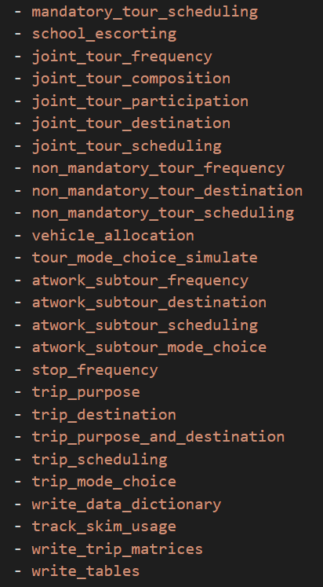
Model Flow
Create tour and trip tables
Insert created pure escort tours
Do not allow joint tours to be scheduled over school escort tours
Recount tour statistics
Calibrated model should have much fewer escort tours created here
Set destination for school escort tours separately
Schedule other half of tour
Apply availability conditions to mode choice
Do not allow additional stops on half tour with school escorting
Insert created school escorting trips
Set destination, purpose, and scheduling separately
Apply availability conditions to mode choice

Slide 19
Tour Frequency
Recount tour statistics
Calibrated model should have much fewer escort tours created here
Includes re-calculating tour_count, tour_type_count, tour_num, and tour_type_num
Necessary for downstream models to run correctly
Performed “under the hood” if school_escorting is run
Suggest a calibration constant in PR to decrease escort tours

Slide 20
Tour Scheduling
Schedule other half of tour
Must be done through utility equations:
Only allow alternatives which coincide with school escorting anchor

Slide 21
Singular Choices
Set destination for school escort tours separately
Take these tours and trips out of model flow and set separately
(removed from the chooser table)
Do not want these tours/trips included in the estimation data bundle
Handle “under the hood” without any user input needed
Set destination, purpose, and scheduling separately

Slide 22
Mode Choice
Set availability tour and trip mode choice:
(model example will allow other modes like transit, etc.)
Apply availability conditions to mode choice
Apply availability conditions to mode choice

Slide 23
Stop Frequency
Set availability in stop frequency configs (work, univ, school, escort):
Merge new trips with school escort trips previously created
Re-calculate stop_frequency
performed “under the hood”
Do not allow additional stops on half tour with school escorting
Insert created school escorting trips

Slide 24
Model Flow
Create tour and trip tables
Insert created pure escort tours
Do not allow joint tours to be scheduled over school escort tours
Recount tour statistics
Calibrated model should have much fewer escort tours created here
Set destination for school escort tours separately
Schedule other half of tour
Apply availability conditions to mode choice
Do not allow additional stops on half tour with school escorting
Insert created school escorting trips
Set destination, purpose, and scheduling separately
Apply availability conditions to mode choice

Slide 25
Status
Have school escort tours and trips created
  Ran all the way through unchanged downstream models with new tours & trips
Have most of model integration done
  Need to test new utility expressions
  A couple of models still need to be separately set
Need to finalize logic for new tour and trip id’s (more next week!)
Implement in SANDAG model and validate against CT-RAMP outputs
Code cleanup and documentation
Target for pull request: August 15

Slide 26

Questions/Discussion

Slide 27
Joel Freedman
Senior Director
Joel.Freedman@rsginc.com
David Hensle
Senior Analyst
David.Hensle@rsginc.com

Slide 28
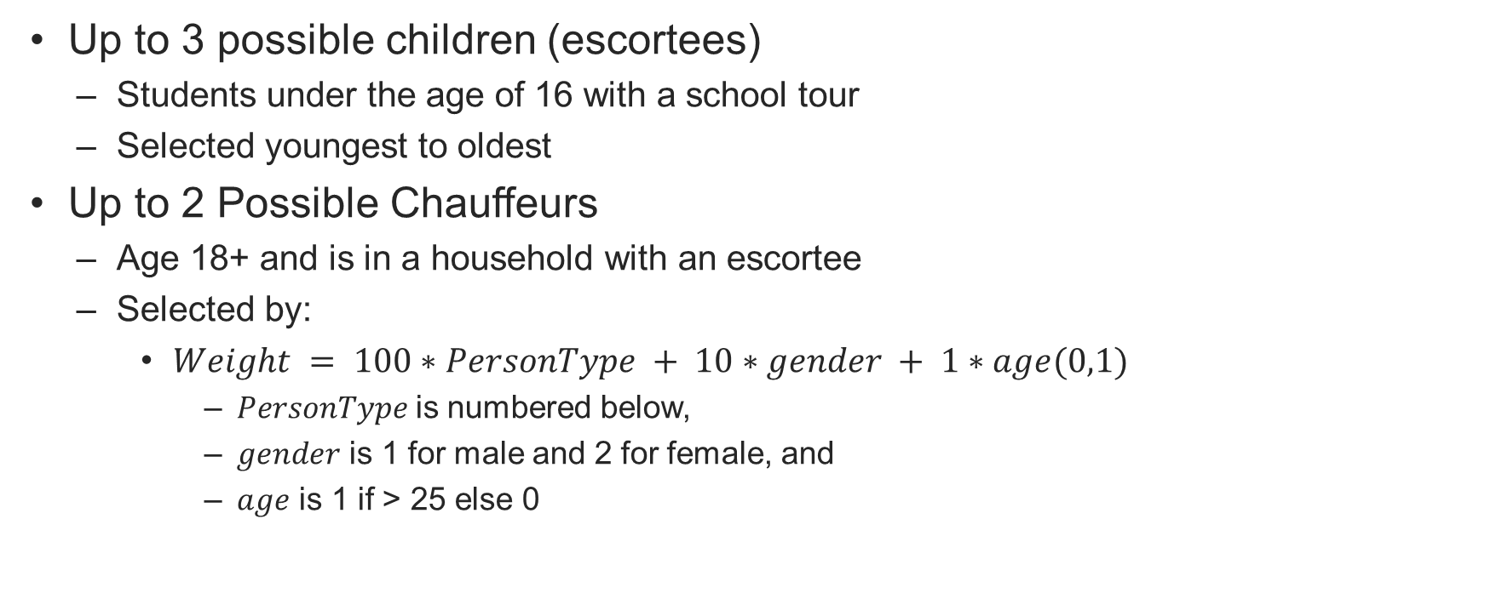
Selecting Chauffeurs and Children
Up to 3 possible children (escortees)
  Students under the age of 16 with a school tour
  Selected youngest to oldest
Up to 2 Possible Chauffeurs
  Age 18+ and is in a household with an escortee
  Selected by:
    $Weight = 100∗PersonType + 10∗gender + 1∗age(0,1)$
      $PersonType$is numbered below,
      $gender$ is 1 for male and 2 for female, and
      $age$ is 1 if > 25 else 0

Slide 29
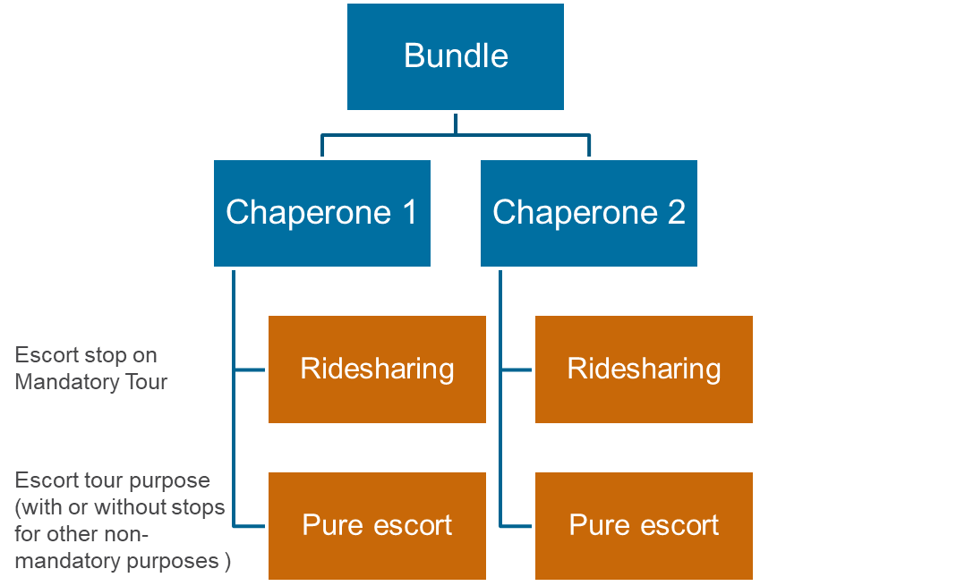
One-Direction Need & Bundling Choice Tree (15 alts)
1,2,3
1+2+3
1+2 / 3
1,2
1+2
1,3
2,3
1
2
3
3
No
2
1
2+3
2/3
1+3
1/3
1/2
1+3 / 2
2+3 / 1
1/2/3
Outbound
Need
Bundling
1 Bundle
2 Bundles
3 Bundles
Child 1
Child 2
Child 3

Slide 30
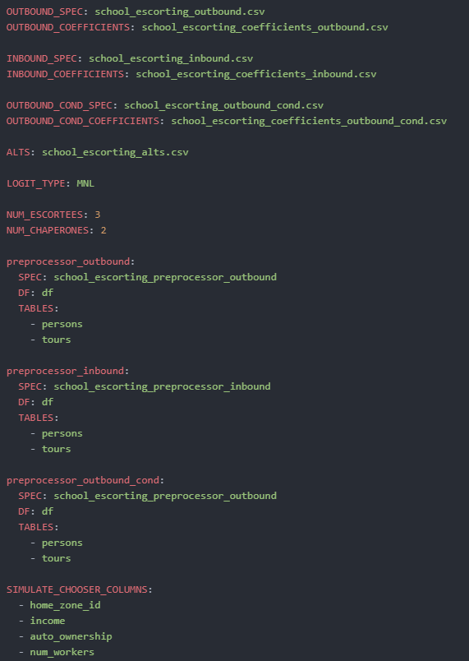
Model Settings
Model is run sequentially
  First outbound
  Then inbound
  Then outbound again!
    Each with their own expressions and pre-processor
Alternatives file supplied
Number of children and chaperones
Keep only important columns to decrease RAM

Slide 31
Tour Level Variables
Tours have school escorting indicators for each direction
Pure escort tours need to be created for the chauffer
  Destination and start time is the same as the first student being dropped off in the bundle
  End time is the start time + time through all school locations
  Tour frequencies and counts need to be re-calculated
Will add column containing bundle chauffer_id & escortee_ids
Tour mode choice needs to match auto occupancy of escort tour
tour_id | person_id | tour_type | household_id | school_esc_outbound | school_esc_inbound
0 | 386007 | escort | 287819 | pure_escort
15826359 | 386008 | school | 287819 | pure_escort | pure_escort
17156153 | 418442 | school | 304036 | ride_share | pure_escort
5 | 594979 | escort | 370262 | pure_escort
24394252 | 594981 | school | 370262 | pure_escort | pure_escort
8 | 644477 | escort | 386761 | pure_escort
26423629 | 644478 | school | 386761 | pure_escort | pure_escort

Slide 32
Trip Level Variables
Create trips to and from school in the correct order
  Add stops for each child in bundle
  Schedules and destinations need to be consistent
  Do not allow stops for chauffer between home and school in outbound direction or school and home in inbound direction
Trip mode needs to match occupancy levels

