Slide 1
ASM-NGS Workshop NCBI Pathogen Detection
Arjun Prasad, Michael Feldgarden, Martin Shumway

Slide 2





NCBI Pathogen Detection Pipeline
NCBI Pathogen Detection Pipeline
NCBI Pathogen Pipeline
BioProject
BioSample
NCBI
SRA
International agencies/
collaborators
GenBank
Basic researchers
Clinical sources
Reports

Slide 3
Pathogen Detection Analysis goals
Are these isolates clonally related?
What is the anti-microbial resistance, stress response, and virulence gene repertoire of this isolate?
Notes:
The Pathogen Detection pipeline was initiated as part of this effort. There are effectively two main analytical goals of the pipeline: 1) the first is to identify if the isolates are clonally related to aid in the identification of food sources making people sick, and the second is to identify the genetic elements contributing to pathogenicity including antimicrobial resistance genes, stress response genes that contribute to environmental persistence, and virulence genes such as toxins. The results are presented in an easy-to-use web interface and I will give a brief demonstration in a few minutes of that for the first point.

Slide 4
Are these isolates clonally related?
What is the anti-microbial resistance, stress response, and virulence gene repertoire of this isolate?
Pathogen Detection Analysis goals
Notes:
The Pathogen Detection pipeline was initiated as part of this effort. There are effectively two main analytical goals of the pipeline: 1) the first is to identify if the isolates are clonally related to aid in the identification of food sources making people sick, and the second is to identify the genetic elements contributing to pathogenicity including antimicrobial resistance genes, stress response genes that contribute to environmental persistence, and virulence genes such as toxins. The results are presented in an easy-to-use web interface and I will give a brief demonstration in a few minutes of that for the first point.

Slide 5
Pathogen Detection Pipeline
SRA
Assembly
Annotation
GenBank
Clustering
AMRFinderPlus
Trees
Goal <24 hours
Notes:
Once sequence data is submitted to NCBI, the Pathogen Detection pipeline automatically assembles and clusters the isolates. Within each cluster, which can consist of two or more isolates represented as assembled genomes, a phylogenetic tree is reconstructed after assembly-to-assembly comparisons are done to identify single nucleotide variants. The clusters are constructed with very short distance thresholds so that the clusters represent clonally related isolates. In parallel we annotated and identifify the antimicrobial resistance genes using PGAP and AMRFinderPlus, a process that is not timebound.

Slide 6
Assembly
Pathogen Detection Pipeline
SRA
Annotation
GenBank
Clustering
AMRFinderPlus
Trees
Goal <24 hours
Notes:
Once sequence data is submitted to NCBI, the Pathogen Detection pipeline automatically assembles and clusters the isolates. Within each cluster, which can consist of two or more isolates represented as assembled genomes, a phylogenetic tree is reconstructed after assembly-to-assembly comparisons are done to identify single nucleotide variants. The clusters are constructed with very short distance thresholds so that the clusters represent clonally related isolates. In parallel we annotated and identifify the antimicrobial resistance genes using PGAP and AMRFinderPlus, a process that is not timebound.

Slide 7
A note about our assemblies
SKESA – High accuracy, high speed de novo assembler
SAUTE – High sensitivity guided assembler can pull apart alleles based on variants represented in at least two reads.
  Guides made from AMR genes (and stx)
Assemblies in GenBank are a concatenation of both
Accuracy
Contig length

Slide 8
AMRFinderPlus
Pathogen Detection Pipeline
SRA
Assembly
Annotation
GenBank
Clustering
Trees
Goal <24 hours
Notes:
Once sequence data is submitted to NCBI, the Pathogen Detection pipeline automatically assembles and clusters the isolates. Within each cluster, which can consist of two or more isolates represented as assembled genomes, a phylogenetic tree is reconstructed after assembly-to-assembly comparisons are done to identify single nucleotide variants. The clusters are constructed with very short distance thresholds so that the clusters represent clonally related isolates. In parallel we annotated and identifify the antimicrobial resistance genes using PGAP and AMRFinderPlus, a process that is not timebound.

Slide 9
AMRFinderPlus Uses a Curated Database, HMMs and BLAST to Identify AMR genes
Proteins
Nucleotide
Report on
resistance genes
integrated into Pathogen Detection Isolate Browser for >2 million pathogen isolates
and MicroBIGG-E
for >1.5 million assemblies
HMMER and
BLAST
Reference
database
https://github.com/ncbi/amr/wiki

Slide 10
AMRFinderPlus - Large Scale Requires Concise Information
hundreds of genomes per day
can’t be ‘artisanal’; flipping through multiple columns/rows/tables will not work
Need concise, discrete signifier that conveys appropriate information about genotype (and possibly phenotype)–the gene symbol (e.g., blaKPC-2, sul1)
The gene symbol is a shorthand for gene function:
  "bla_{KPC-33}" means "inhibitor-resistant extended spectrum class A beta-lactamase KPC-33"
Incorporate ambiguity and accurate specification
    KPC-2: carbapenemase
    KPC-33: inhibitor-resistant cephalosporinase (1 aa change from KPC-2)
    KPC-8: inhibitor-resistant carbapenemase (2 aa changes from KPC-2)
    A novel KPC family enzyme could have any of these phenotypes

Slide 11
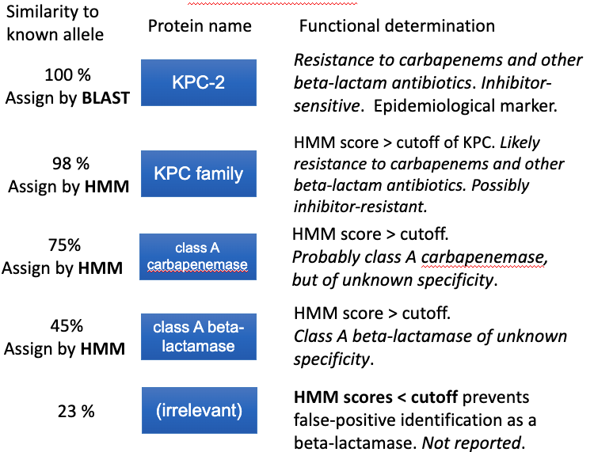
AMRFinderPlus Uses a Curated Hierarchy
Makes an affirmative statement as to what the gene should be called
Attempts to give the sequence the name that one of our curators would give it if they were looking at it manually​
Avoids overspecification and incorporates ambiguity​, to prevent incorrect information about possible phenotype:
  e.g., not calling a novel KPC family enzyme of unknown function “KPC-2 carbapanemase” because it is the closest hit
https://github.com/ncbi/amr/wiki
Notes:
The missing headers would say “identity”, “assignment”, and “reason”, I guess

Slide 12
Reference databases
Data used by AMRFinderPlus to identify genes and point mutations
Reference Gene Catalog
Every row is a reference gene or point mutation
1,000 X N
Download reference sequences
Reference Gene Hierarchy
Every row is a node in our hierarchy
1000 X N
Reference HMM Catalog
Every row is an HMM
100 X N
Notes:
The prediction tool, the reference sets, and the results of the predictions are made available in various data formats including easy-to-use web browwsers. There are over 1 million pathogen isolates, and over 10 million predicted genes and point mutations found in these pathogens. Together these comprise the National Database of Antibiotic Resistant Organisms. (The NIH/NLM/NCBI NDARO is a collaborative, cross-agency, centralized hub for researchers to access AMR data to facilitate real-time surveillance of pathogenic organisms, which currently contains genomic data for nearly one million pathogen isolates collected from publicly available information. Many of these isolate entries include integrated antibiotic susceptibility phenotypic data, antibiotic resistance genotypic data, and detailed information on the sequences encoding resistance genes found in these isolates.) The NIAID funded PATRIC resource uses NDARO as one of its data sources.

Slide 13
Pathogen Detection Isolate Browser
Every row is an assembled isolate
Analysis results
1,000,000 X N
Download genomes
MicroBIGG-E (Microbial Browser for Identification of Genetic and Genomic Elements)
Every row is an AMR, virulence, and/or stress response genes with method, type, subtype, class, subclass, and supporting evidence
AST Browser
Submitted Antibiotic Susceptibility test results
100,000 X N
10,000,000 X N
Download genes,
genes + flanks, contigs
MicroBIGG-E Map
Graphic display of MicroBIGG-E data

Slide 14
Understanding AMRFinderPlus: Class and Subclass
Class represents broad class of drugs to which resistance can be conferred; e.g., "AMINOGLYCOSIDE"
Subclass has more specificity and can include groups of drugs or individual antibiotics; e.g., "AMIKACIN/TOBRAMYCIN"
Beta-lactamase resistance (BETA-LACTAM) is divided into 3 subclasses:
  BETA-LACTAM: unknown/unclear resistance OR resistance to penicillins
  CEPHALOSPORINS: resistance to 2nd generation (or newer) cephalosporins
  CARBAPENEMS: resistance to some (or all carbapenems)
Note: many virulence genes will lack values for these fields

Slide 15
Acknowledgements
Richa Agarwala
Victor Ananiev
Azat Badretdin
Slava Brover
Joshua Cherry
Jinna Choi
Vyacheslav Chetvernin
Pavan Chilamakuri
Robert Cohen
DeAnne Cravaritis
Michael DiCuccio
Olga Ermoleava
Boris Fedorov
Mike Feldgarden
Lewis Geer
Renata Geer
Dan Haft
Lianyi Han
Avi Kimchi
Michel Kimelman
William Klimke
Alex Kotliarov
Valerii Lashmanov
Aleksandr Morgulis
Eyal Moses
Chris O'Sullivan
Arjun Prasad
Edward Rice
Kirill Rotmistrovskyy
Alejandro A. Schaffer
Nadya Serova
Sergey Shiryev
Martin Shumway
Oleg Shutov
Douglas Slotta
Alexandre Souvorov
Tatiana Tatusova
Francoise Thibaud-Nissen
Igor Tolstoy
Ed Wachtel
Lukas Wagner
Jay Worley
Hlavina Wratko
Chunlin Xiao
Alexander Zasypkin
Eugene Yaschenko
Mingzhang Yang
David Lipman
James Ostell
Kim Pruitt
Stephen Sherry
ASM
APHL
BWH
CDC
FDA/CFSAN
FDA/CVM
GenFS
USDA-FSIS
PHAC/CFIA
PHE/FERA
NIAID
Wadsworth/MDH
pd-help@ncbi.nlm.nih.gov
This work was supported in part by the National Center for Biotechnology Information of the National Library of Medicine (NLM), National Institutes of Health, as well in part by the National Institute of Allergy and Infectious Diseases,
National Institutes of Health

